Slide 1
Sensor Networks for local and global climate observations

Slide 2
Contents
1.Motivation
2.Goals
3.Design Patterns
4.Breif Description of Design Patterns
5.Use Case Scenario
6. Class Diagram
7.Implementation
8. UX Design
9.Separation of concerns among 20 persons

Slide 3
There has been an unprecedented rise in sea level , mainly due to human-induced climate change, which is expanding the world oceans and melting the ice sheets and glaciers resulting in coastal erosion and floods.
Motivation

Slide 4
To design an application that provides an innovative approach to monitor one of the many problems with climate changes that is the rising sea level and the prediction of floods using sensor networks.
Goal

Slide 5
Design Patterns
Composite
Memento
Observer
Adapter
Builder

Slide 6
Design Patterns
Composite Design Pattern
The Composite Pattern enables a class in high hierarchy levels to represent individual objects as well as group objects. Basically, there are three components apart from the client: the Component, the Leaf and the Composite.
Builder Design Pattern
The goal of the builder pattern is to separate the architecture from the final representation of a complex object.
Memento
The Memento pattern, also known as Token pattern, is a behavioral design pattern that enable saving and restoring the previous state (undo) of an object without revealing the details of its implementation.
Adapter
The adapter pattern connects two different connections or interfaces that are not compatible with each other. Adapter class adapts to the target class. Adapter class bridges the properties of the target class. Adapter also adapts subclasses.
Observer
The Observer pattern, also known as Publish-Subscribe pattern, defines a one to many dependency between objects, so that if one object changes its state (subject), all of its dependents (observers) are notified and updated automatically

Slide 7
Use-case Scenarios
Find Sensors and Reading Sensor details locally and geospatially
Display Details of configuration and Simultaneously displayed the prediction of Flood
Send warning alert to all users when the sea level limit exceeds
d
.
Configure frequently monitored sensors
d
Manage the added configurations

Slide 8
Use-Case Scenarios
Find Sensor and Reading Sensor Details locally and geospatially
As a user, we want to find the sensor available for sea level detection and read the data.
Display details of configuration and simultaneously display the prediction of floods
As a user, we want to display the details of configuration in graph, chart format and geo map format and simultaneously calculate the flood prediction using algorithms and display the prediction of floods.
Configure a frequently monitored sensors.
As a user, we want to add a configuration with the set of sensors that we use frequently.
Configuration Management
As a user, we want to manage the configuration added to monitor sensors.
Send warning alert to all users when the parameter limit exceeded
As a user, we want to get notified of an alert warning, when the sea level limit exceeds.

Slide 9
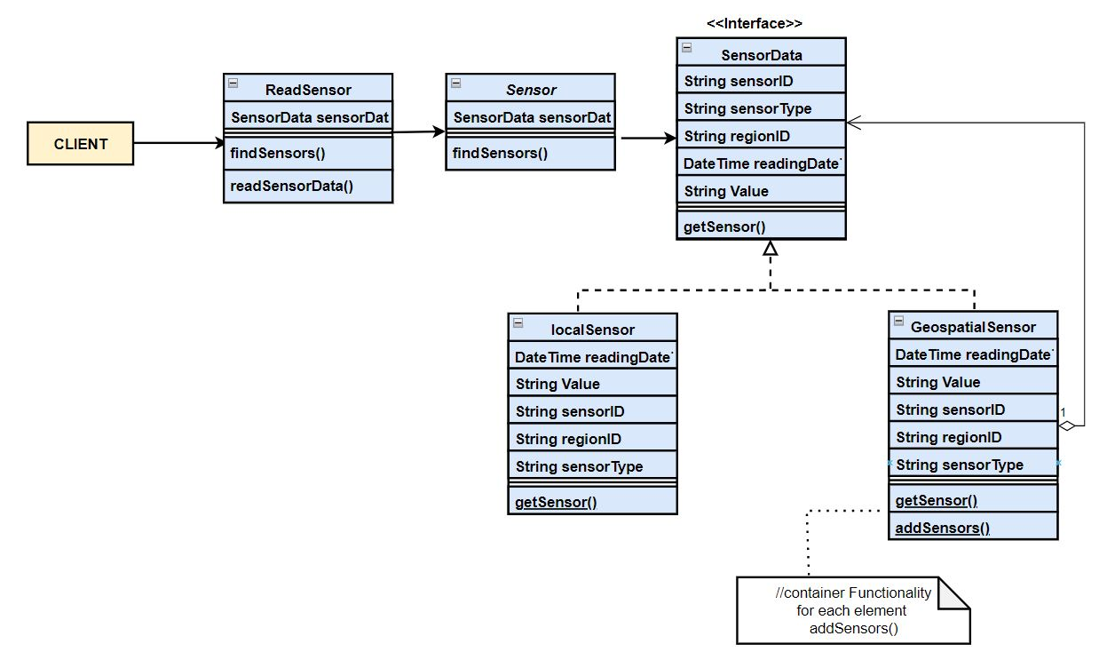
Class Diagram(Reading Sensor Data)

Slide 10
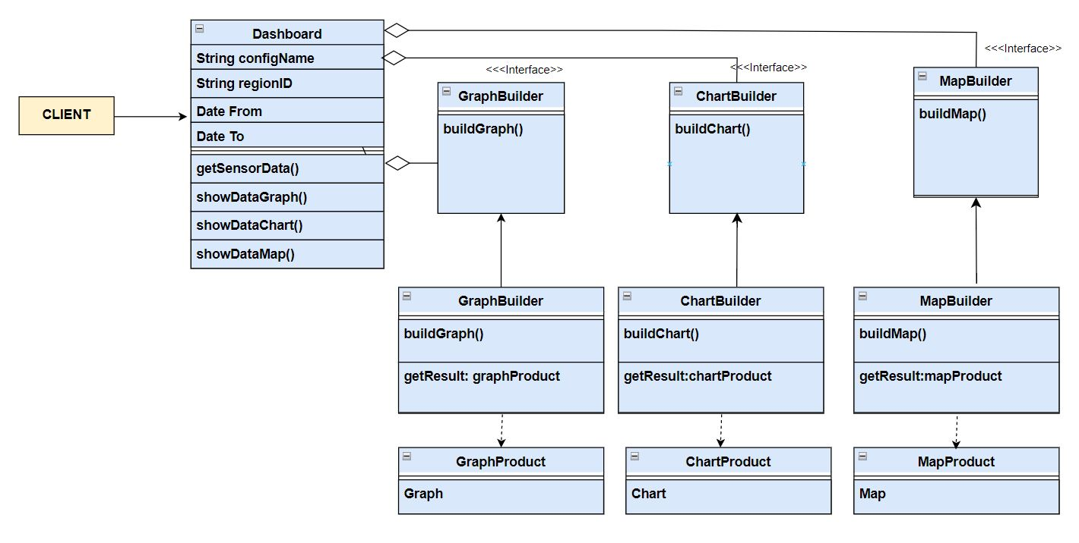
Class Diagram(Dashboard Screen)

Slide 11
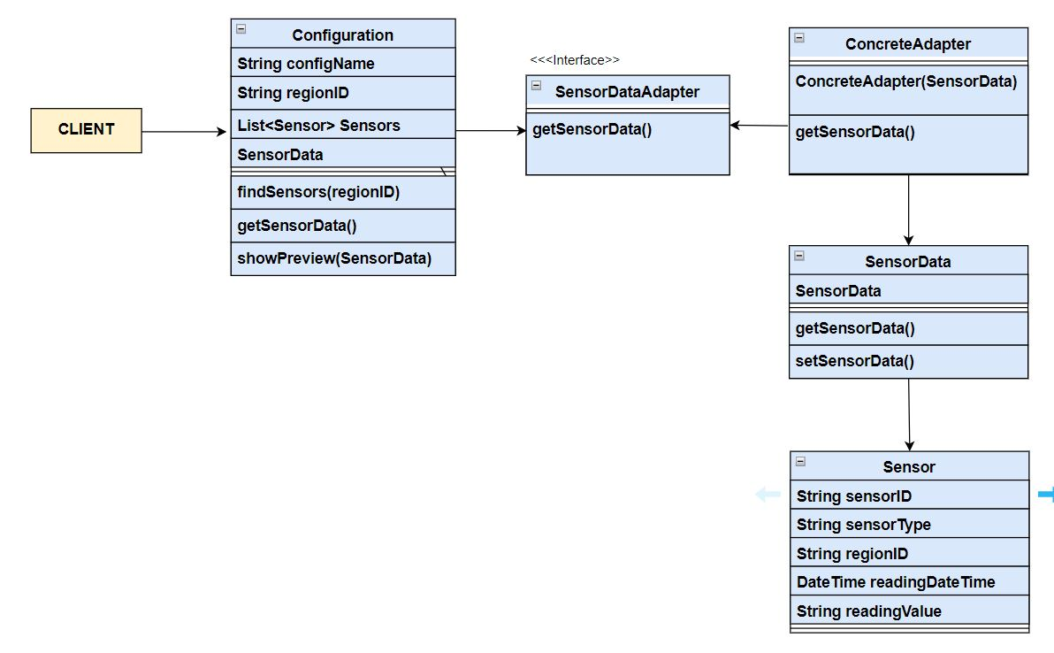
Class Diagram (Configuration Screen)

Slide 12
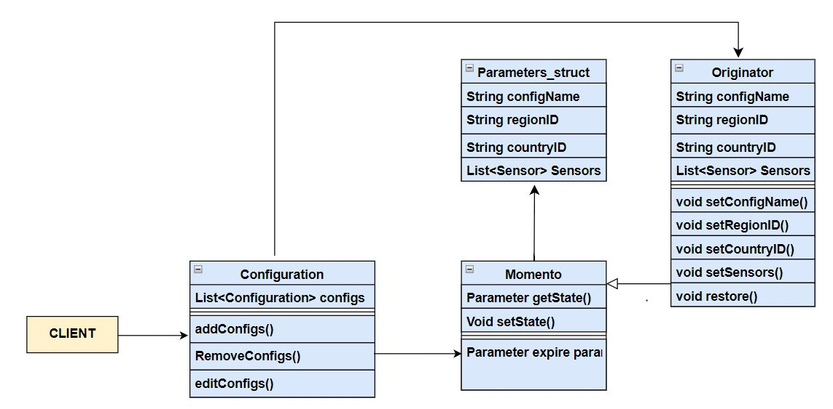
Class Diagram (Configuration Management)

Slide 13
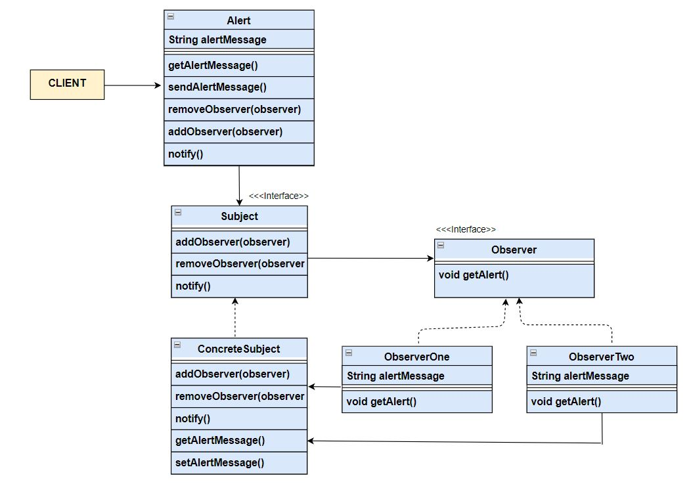
Class Diagram (Alert Screen)

Slide 14
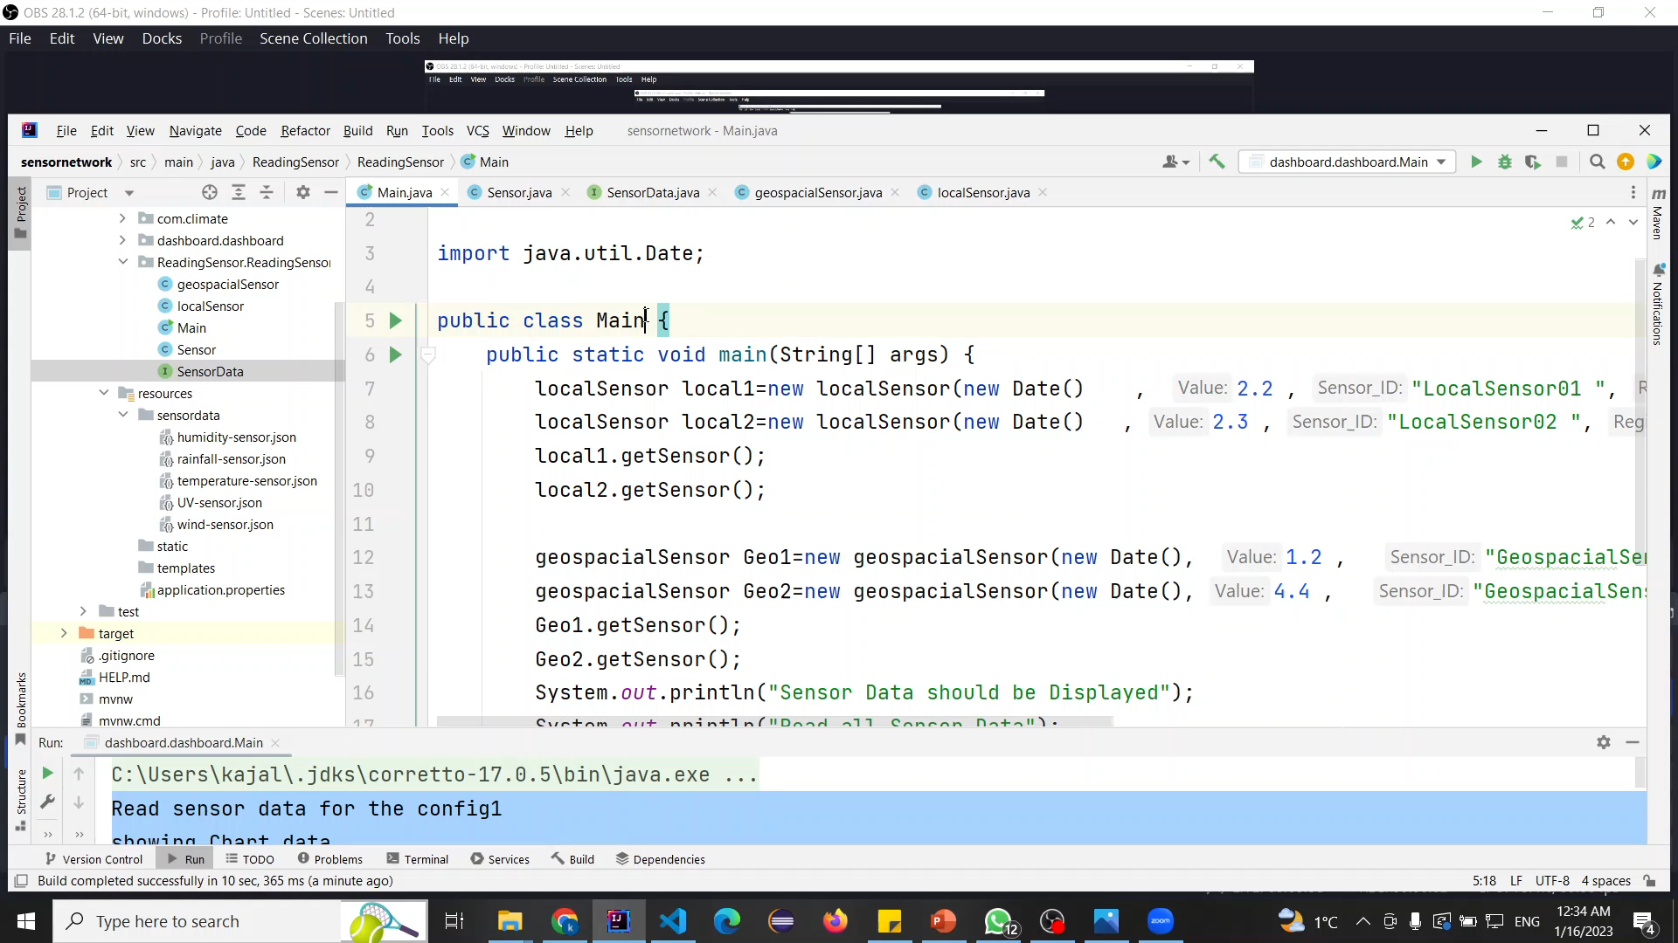
Reading Sensor Data

Slide 15
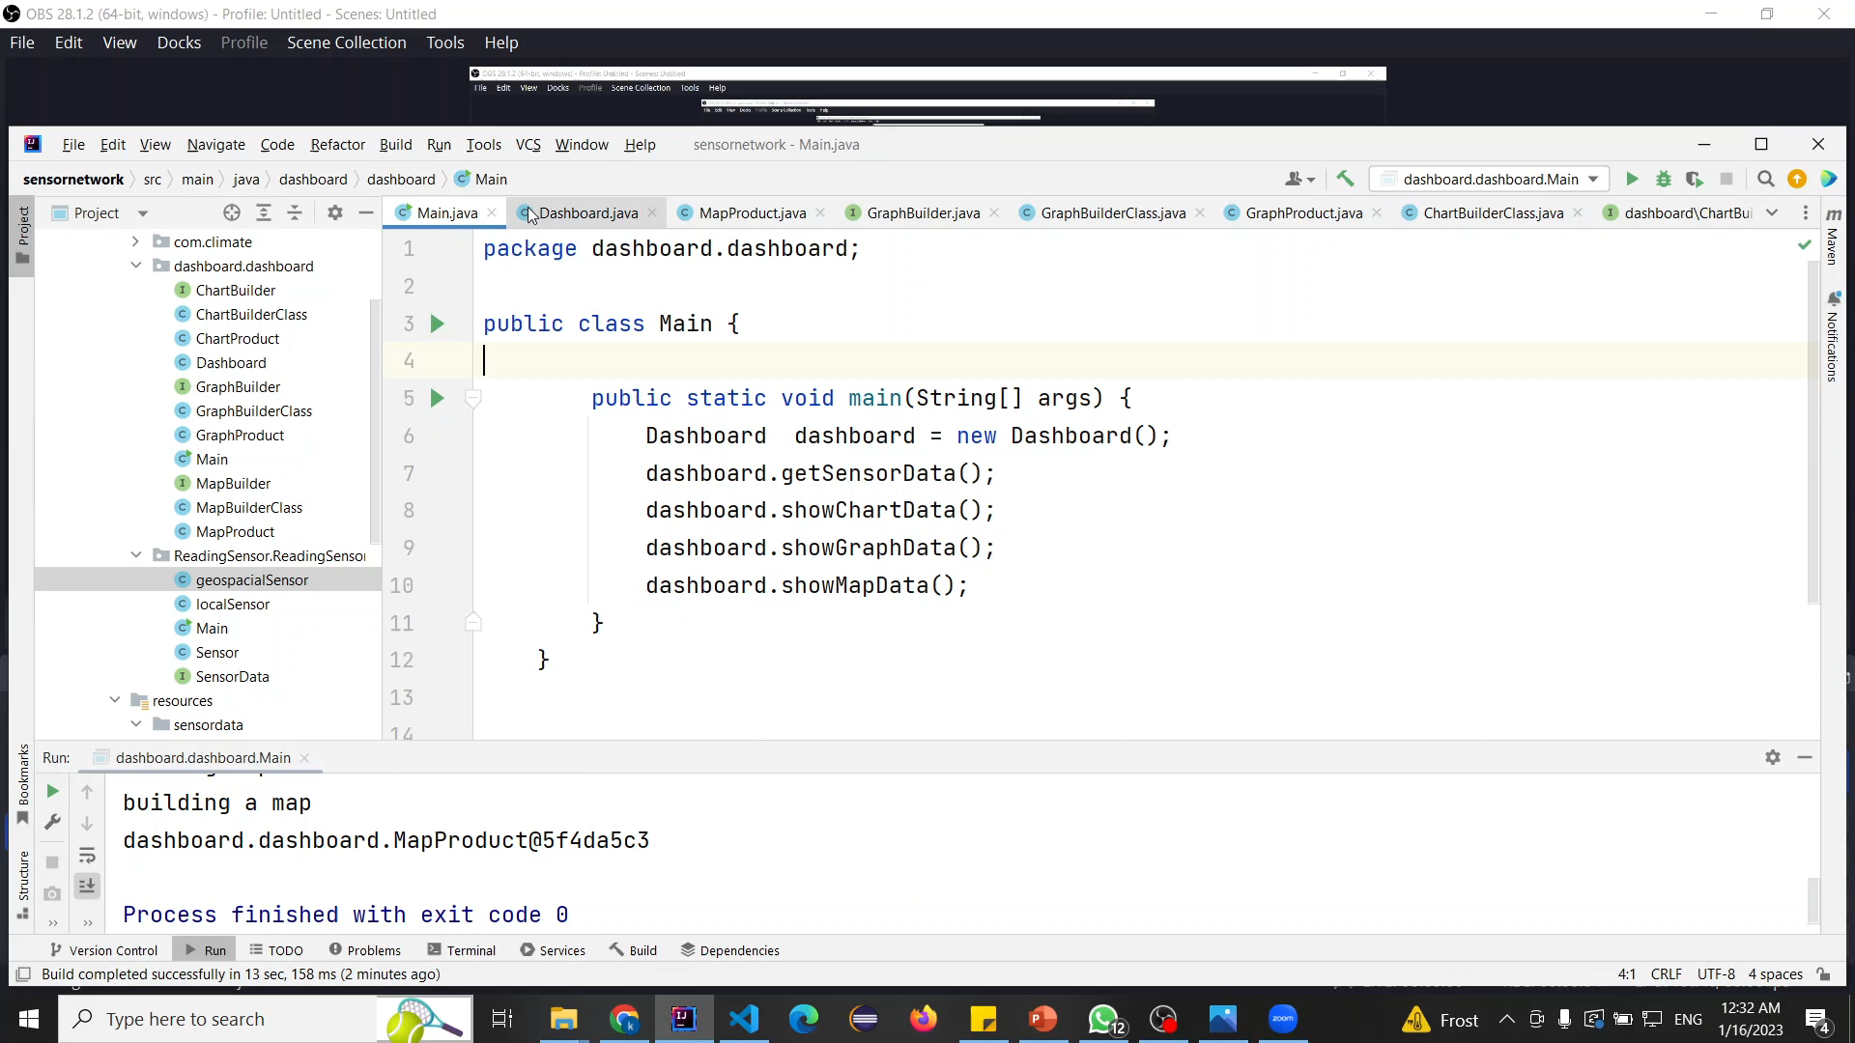
Monitoring Dashboard

Slide 16
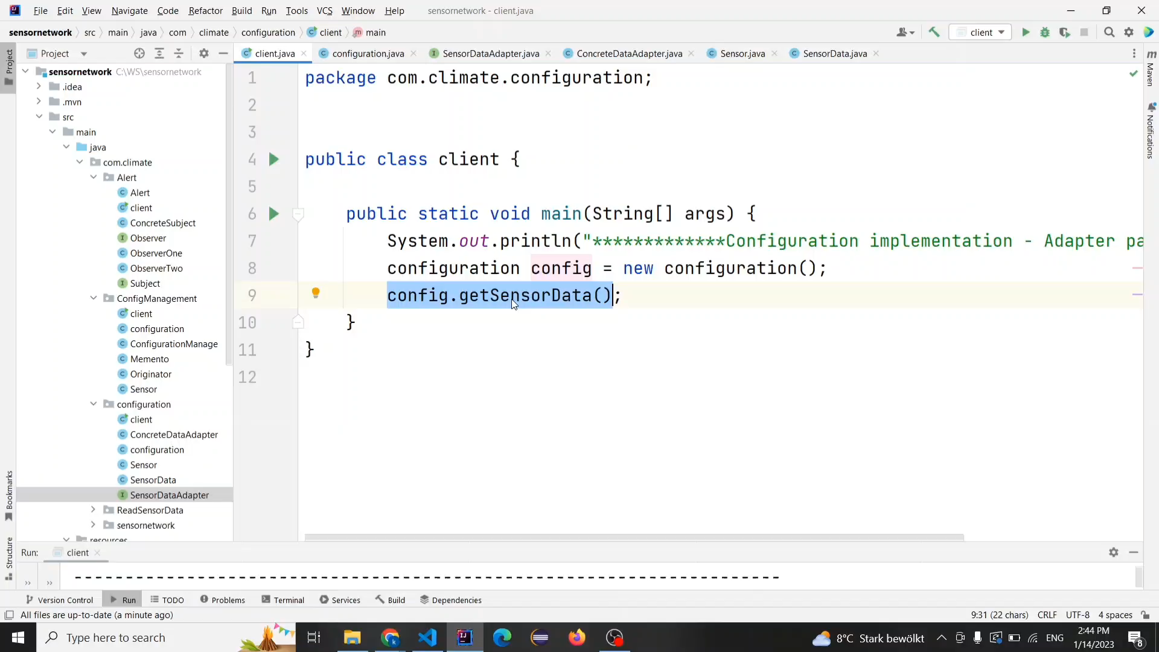
Configuration Screen

Slide 17
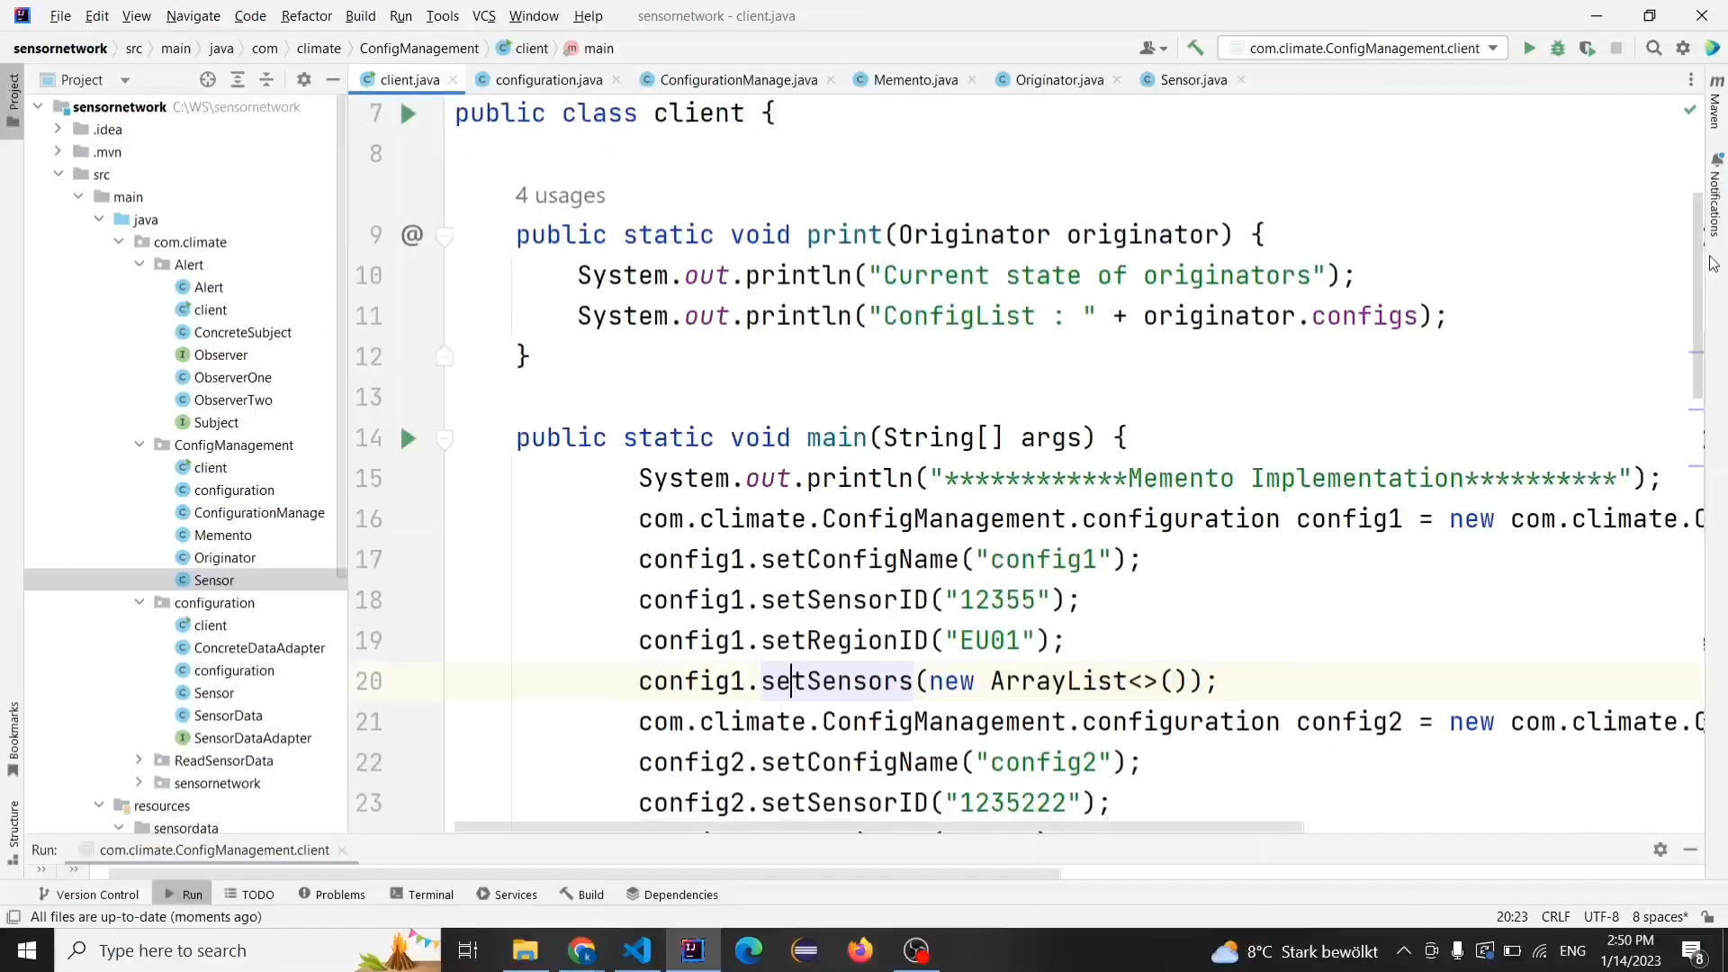
Configuration Management

Slide 18
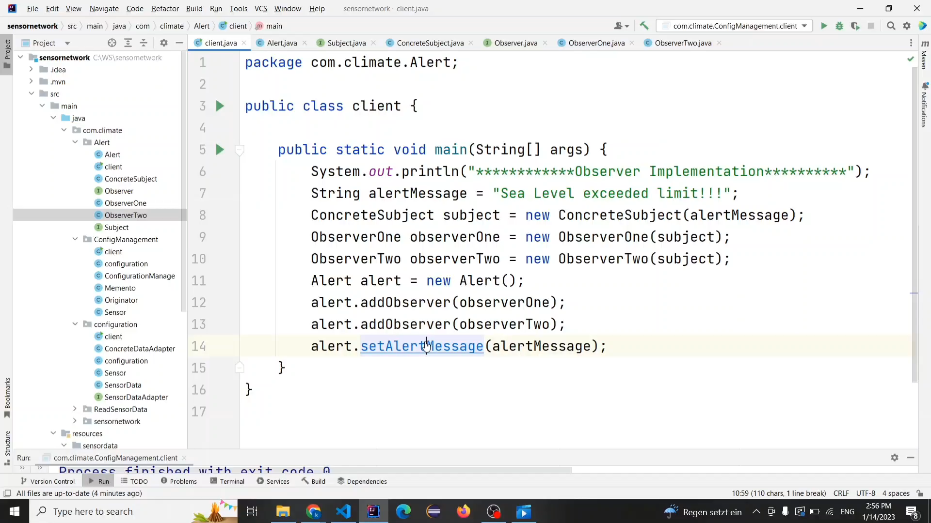
Alert Display

Slide 19
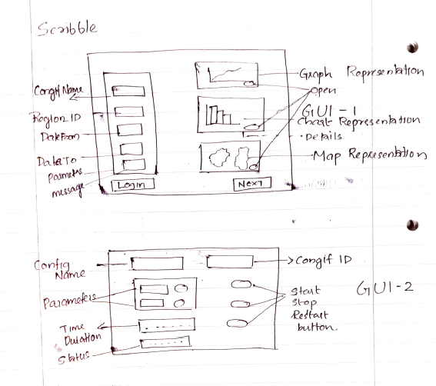
Sample GUI for Use Case 6:
Scribble

Slide 20
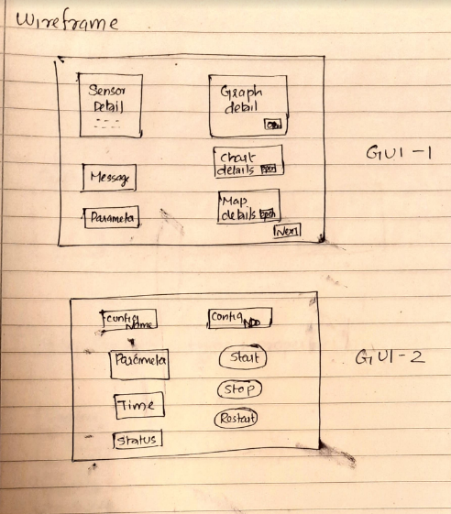
Sample GUI for Use Case 6:
Wire Frame

Slide 21
Separation of concerns among 20 persons
1 Year task distribution for 20 Person
2 Person - Finding sensors and data collection and then database handling
1 Person - Design Architecture. 2 Person – Read Sensor data use case (Composite pattern) 3 Person – Monitoring Dashboard use case (Builder pattern)
2 Person – Configuration screen use case (Adapter pattern)
2 Person – Configuration Management use case (Memento pattern)
2 Person – Alert screen use case (Observer pattern)
2 Tester for all different sub-use cases of application 1 Graphical User Interface developer 2 Profile creator and manager responsible for all profile operation such as register, login and logout
1 person to check and maintain the health check of sensors

Slide 22
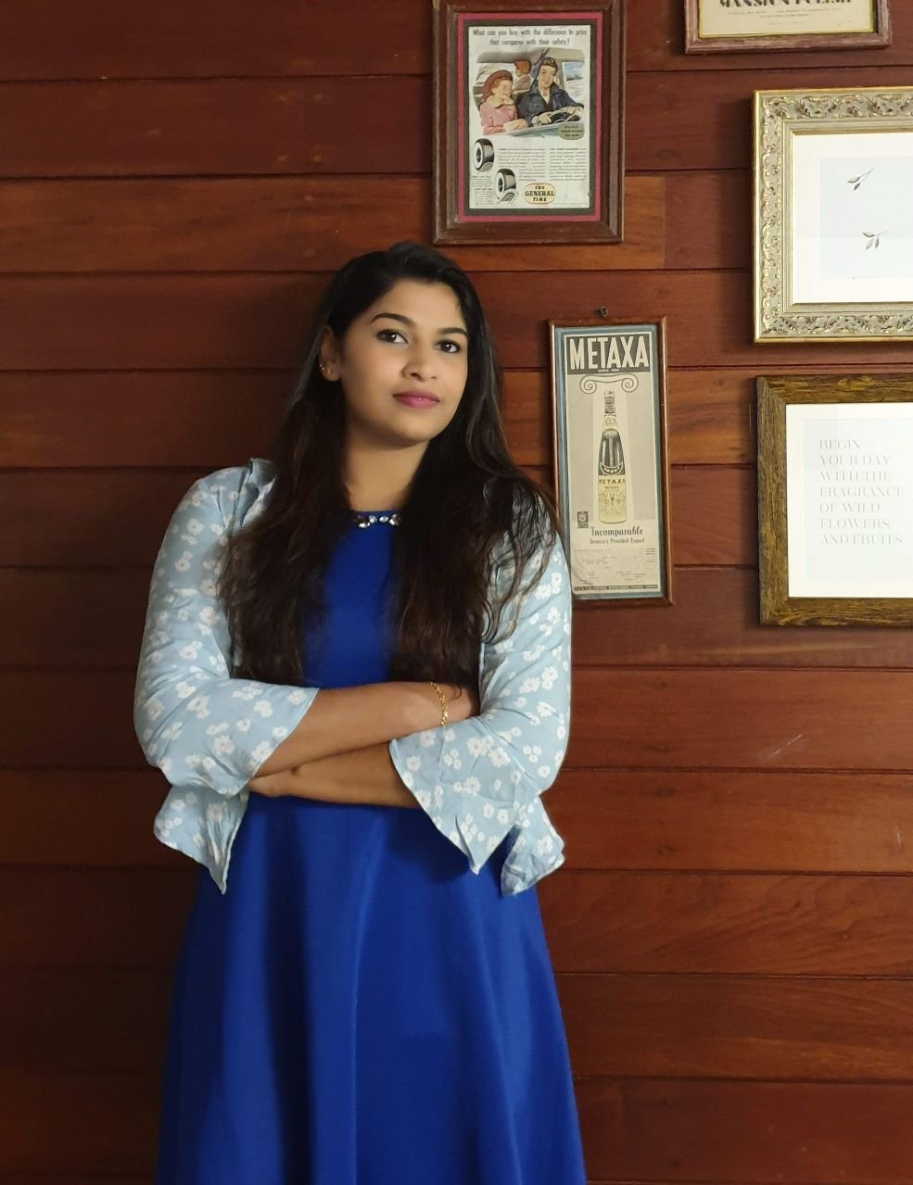
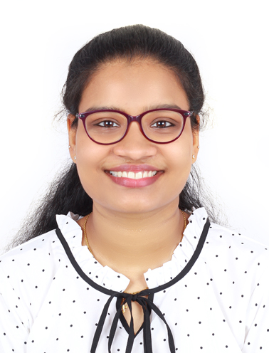

Our Team
Kajal Chellappan
Sonya Thomas

Slide 23
THANK YOU

